Slide 1
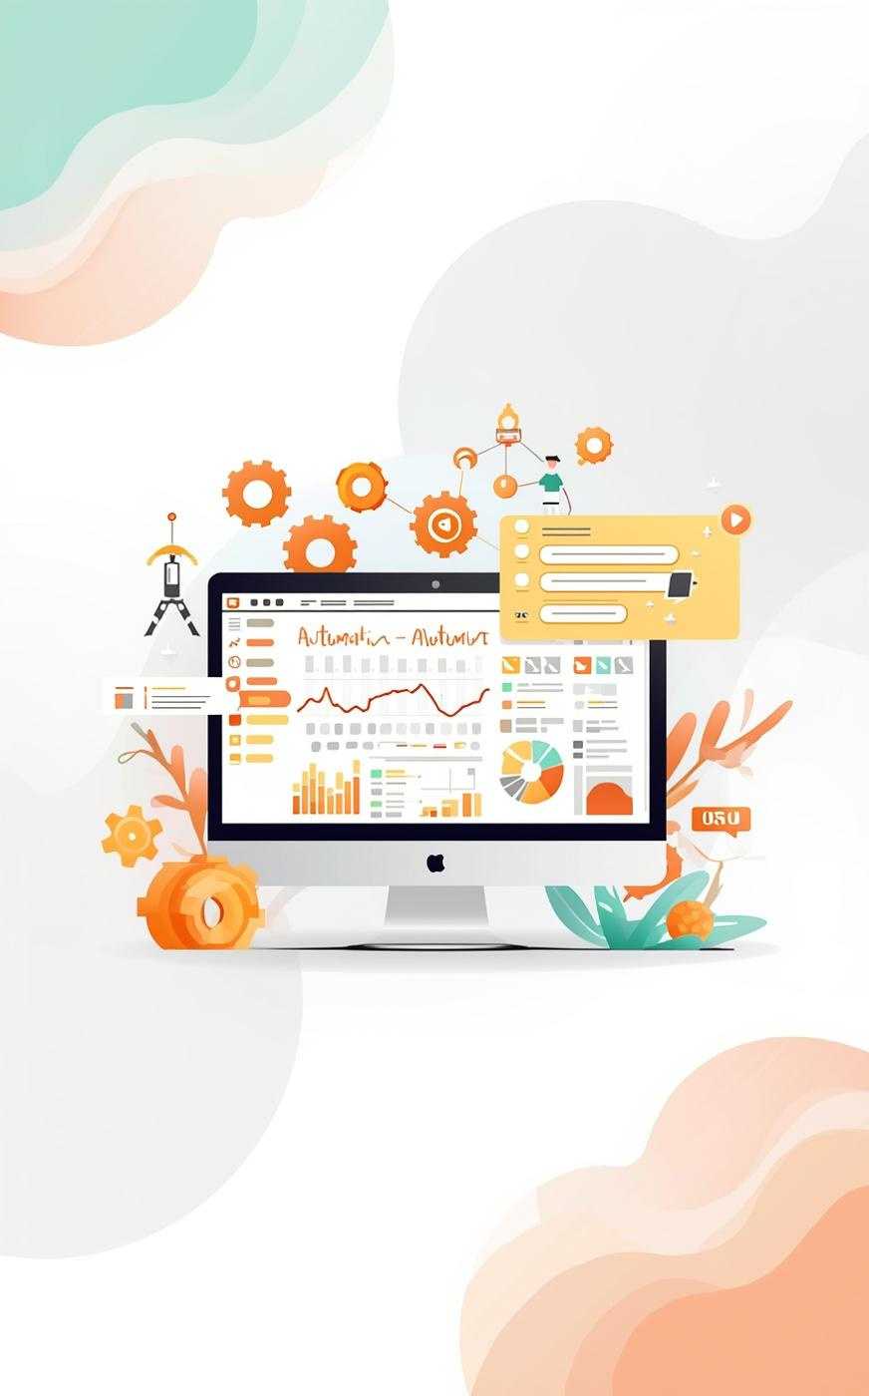

Building Agents with n8n
Dana Haddad & Josh Bradley
Notes:
Dana: “Hey everyone! Welcome to Building Agents with n8n — An Open-source Perspective. I’m Dana, and this is Josh — AI architect, open-source tinkerer, and my favorite demo co-pilot.” Josh: “Hi folks! I’m excited to show how we can use open tools to build AI agents that actually work for you — not the other way around.” Dana: “Quick show of hands — who here has an inbox that’s slightly out of control?” Perfect. Because today, we’ll build a simple, open-source agent that reads your email, decides what’s urgent, and sends you an alert in Telegram — all with n8n.”

Slide 2
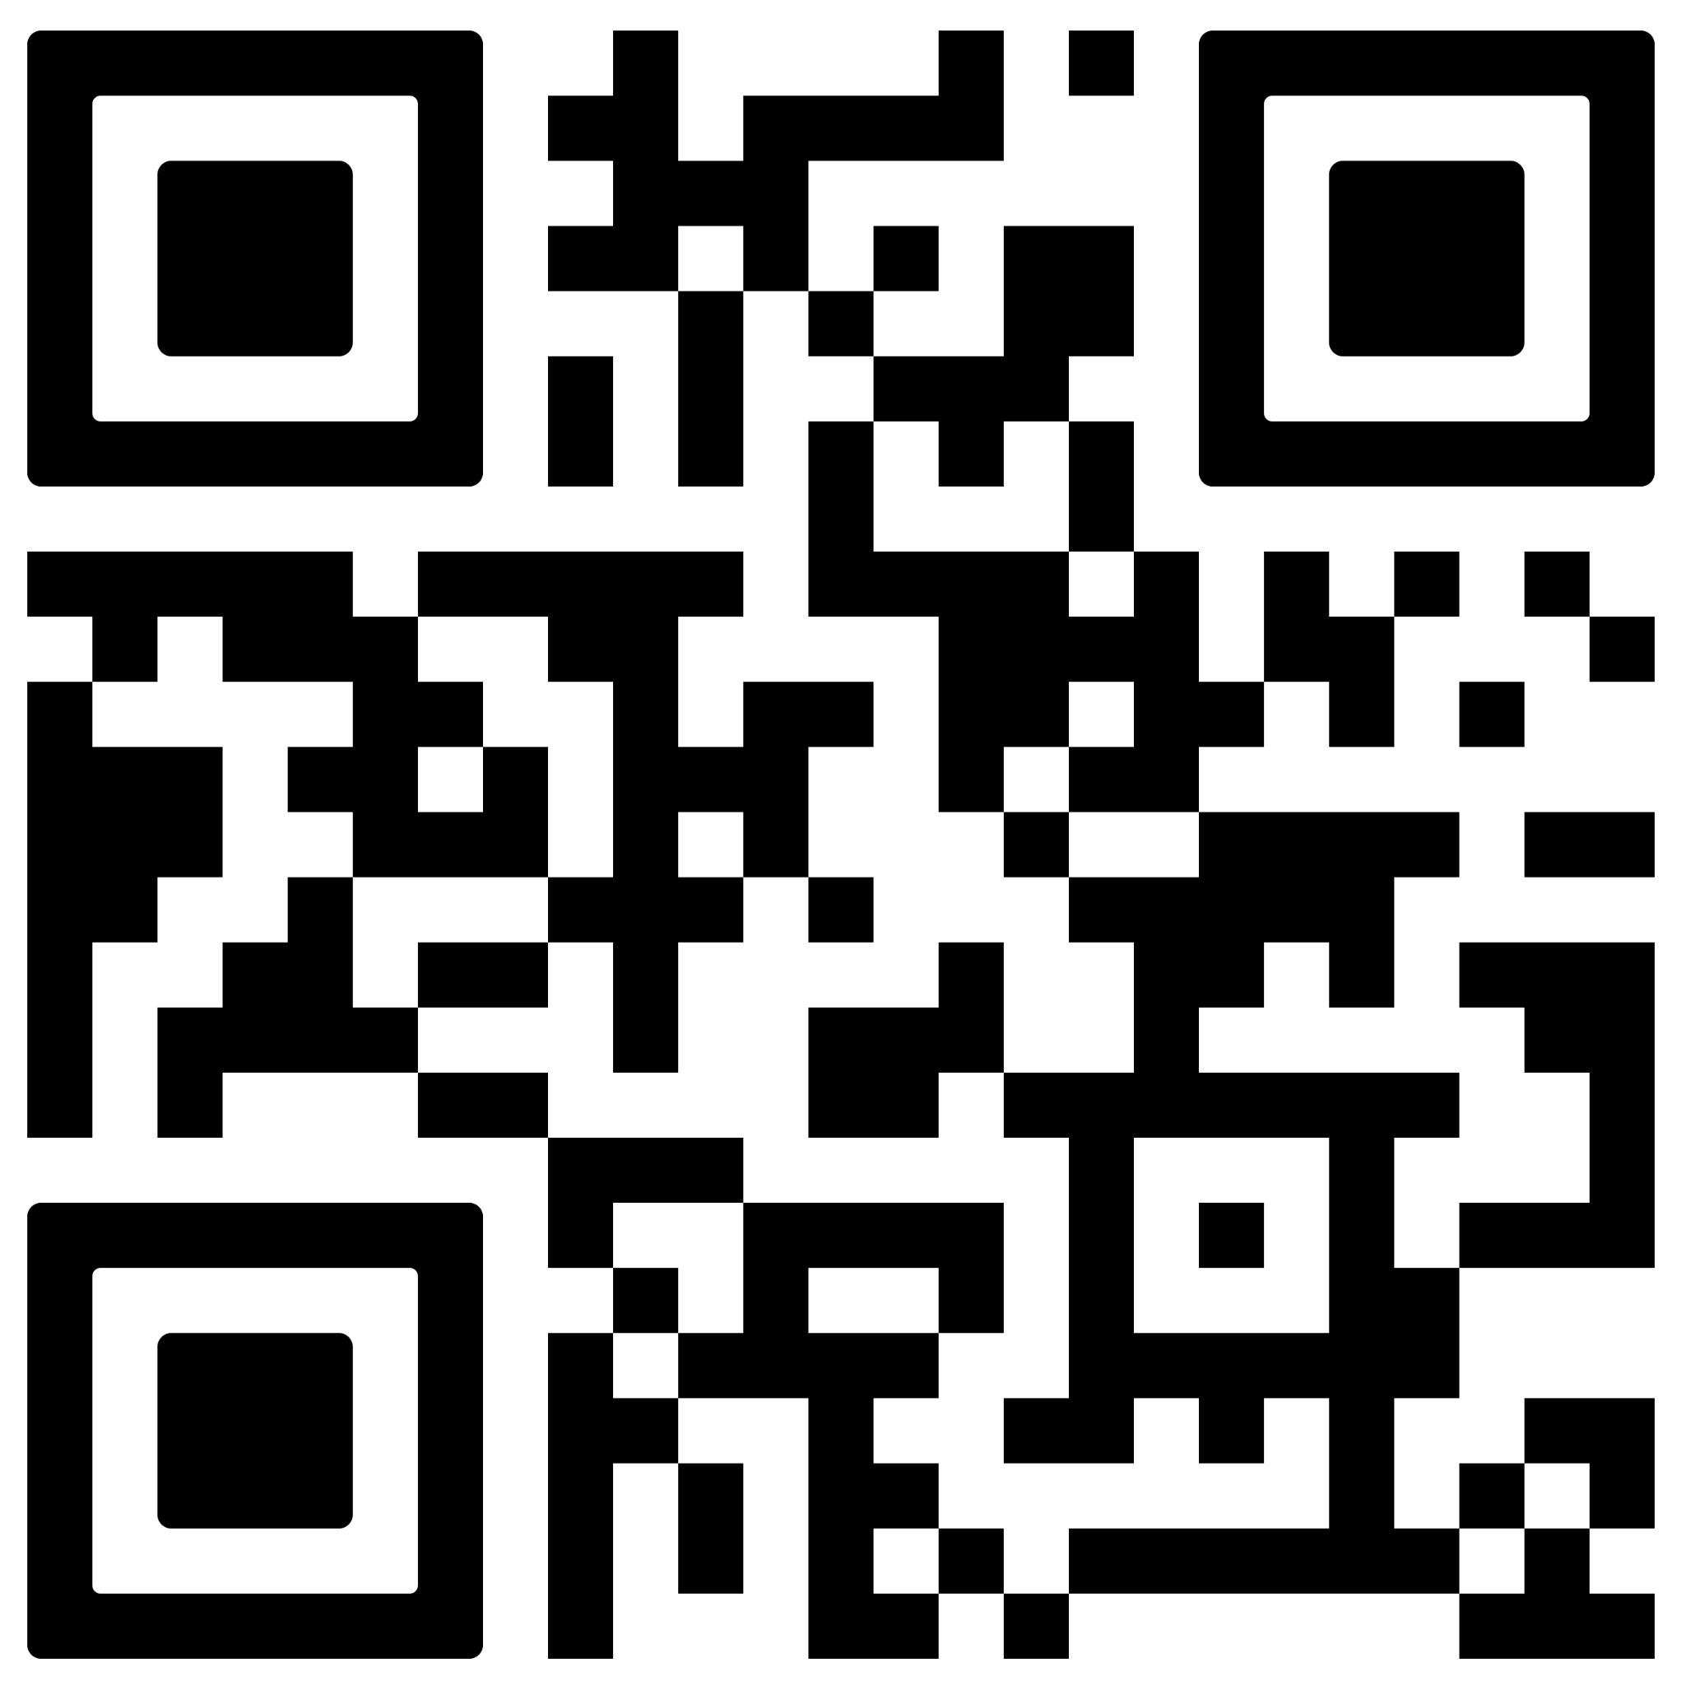
Materials
Slides, code, and examples
If you’d like to view these materials later, scan this QR code. This will take you to a public github repo.
*No warranty expressed or implied.
Notes:
Josh: “Scan this QR code to access these slides, a script to set this up locally, as well as the workflow examples we’ll walk through. No warranty expressed or implied.”

Slide 3

Why Open-source Matters
01
02
03
Open-source is about community and accessibility.
Ownership encourages innovation, inspiring individuals to develop unique solutions collaboratively.
Open-source promotes transparency, leading to enhanced creativity and innovation.
Notes:
Josh:
“When Dana and I were deciding what to do in the workshop our first question was, what’s our budget. When we found out it was zero, we immediately thought of open-source.“
Dana:
“When people talk about agentic AI, they often think of closed systems — black boxes that make decisions you can’t see.
But Open-source flips that. You can inspect, fork, and extend your own automation.”
Josh:
“And that’s why n8n and these other open-source options are so powerful — they’re open, self-hostable, and composable. You can connect APIs, models, or even your own scripts. Nothing hidden.”
Dana:
“So today’s theme: transparency breeds creativity. We’ll build an agent together — one you fully own and understand.”

Slide 4
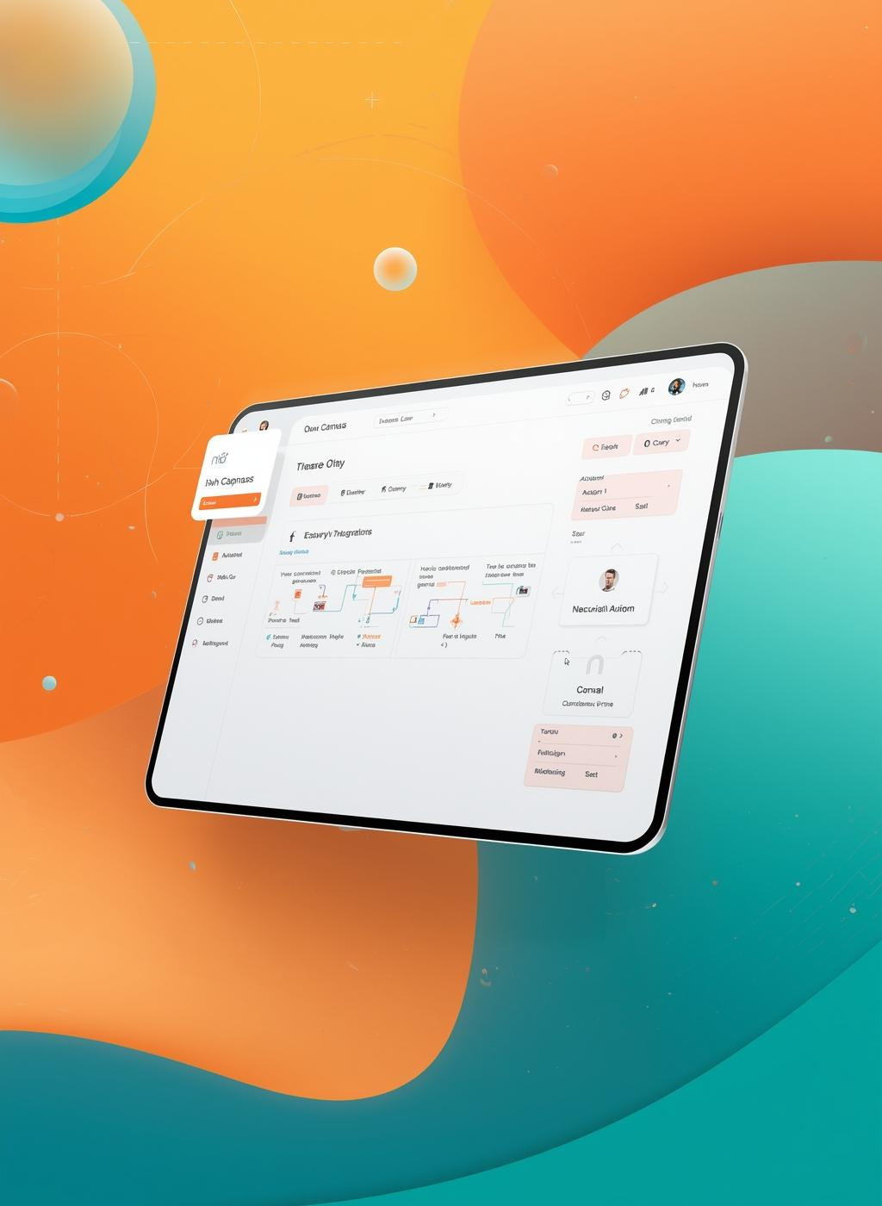
Meet the Tools
Your gateway to open-source automation
n8n is a powerful workflow automation tool that allows users to connect over 400 apps visually. Embrace open-source flexibility to build customized solutions without the fear of vendor lock-in.
Notes:
Dana: “n8n, which stands for Nodemation, is like open-source LEGO for workflows. Every node is one piece — triggers, logic, actions — and you can snap them together however you want. Everything’s visual, portable, and shareable. There’s no lock-in — you can even export and share the workflow JSON.”

Slide 5
Meet the Tools
Your gateway to open-source automation
OpenWebUI is an intuitive interface designed for managing and interacting with AI models locally. It empowers users with a clean, browser-based experience to run models without relying on cloud services.
Notes:
Josh:
“By show of hands, who's currently paying for an AI subscription?“ “Okay, now keep those hands up if you'd like to stop paying for it.“ <pause>
“Open WebUI is your “ChatGPT” like experience for interacting with Ollama. It gives you a familiar UI with drop-down model selection. ”

Slide 6
Meet the Tools
Your gateway to open-source automation
Ollama brings simplicity to running large and small language models on your own machine. With a lightweight CLI and local-first approach, it enables developers and enthusiasts to pull, run, and experiment with cutting-edge models without complex setup.
Notes:
Dana:
“Ollama is the hosting engine that allows you to host models locally. One of the best things about Ollama is it won't remind you that your free trial is ending.”

Slide 7


Classify Your Inbox
Automate Email Sorting
Using the Gmail Trigger, Classification Agent, and Ollama nodes, we can identify urgent, family, SPAM, and other types of email through a single agent, ensuring dynamic classification and improved email management.
Notes:
Dana: “Let’s build the Inbox Zero Agent — open-source style. When a new email lands, we’ll teach it to decide if it’s urgent or not.” Josh: “Starting with the Gmail Trigger node — open integration, no proprietary connectors. Then we’ll add an Ollama node for classification.” (Prompt example) “Read the email subject and body. Respond ONLY with Urgent or Normal.” (Tests: 'Server down — please help!') Josh: “Result: Urgent. Looks good.” Dana: “Already thinking for itself — but fully transparent. Every step’s visible, editable, auditable.”

Slide 8

Add Intelligence
Ollama Summarization Node
Integrating the AI Agent summarization node and our local Ollama models enhances our agent's capabilities by providing a custom email specific to the sender’s request or concern.
Notes:
Dana:
“What if we made those Telegram messages more useful?”
Josh:
“Adding a second Ollama node — ‘Summarize this email for an executive Telegram update.’”
(Runs flow again — Telegram shows concise summary.)
Dana:
“That’s practical intelligence. Still open, still inspectable — and now genuinely helpful.”

Slide 9

Take Action
Automate Your Responses
Utilize the Telegram Send Message node to automate alerts for urgent emails, ensuring effective communication while maintaining transparent orchestration in your workflow.
Notes:
Dana:
“Now let’s make it act.
When it sees ‘Priority,’ it’ll send a message straight to Telegram.”
Josh:
“Adding a Switch node, and then a Telegram Send Message node.
This is open-source orchestration — every integration powered by APIs you control.”
(Runs live test.)
Josh:
“Boom — Telegram alert: 🚨 Urgent email from IT — Server outage reported.”
Dana:
“And that’s the magic.
In 10 minutes, we built a real-time agent — using open APIs, visible logic, and zero proprietary dependencies.”

Slide 10

Local, Private Chat
Personal Chat Agent
Open WebUI locally provides a free, customizable chat interface with complete privacy, enabling you to run multiple open-source models like Llama or Mistral while maintaining full control over your data and conversations without subscription costs.
Notes:
Dana: "Now let's see it in action locally. Open WebUI gives us a clean chat interface — no cloud, no subscriptions, just pure local control.“
Josh: "Spinning it up with Docker, connecting to our Ollama models. This is self-hosted AI — every conversation stays on our hardware, every model we choose to run."
(Demonstrates live chat.)
Josh: "Boom — chatting with Llama 3, switching to Mistral, all running offline on this machine.“
Dana: "And that's the beauty. In minutes, we have a full AI interface — complete privacy, total customization, and zero vendor lock-in."

Slide 11
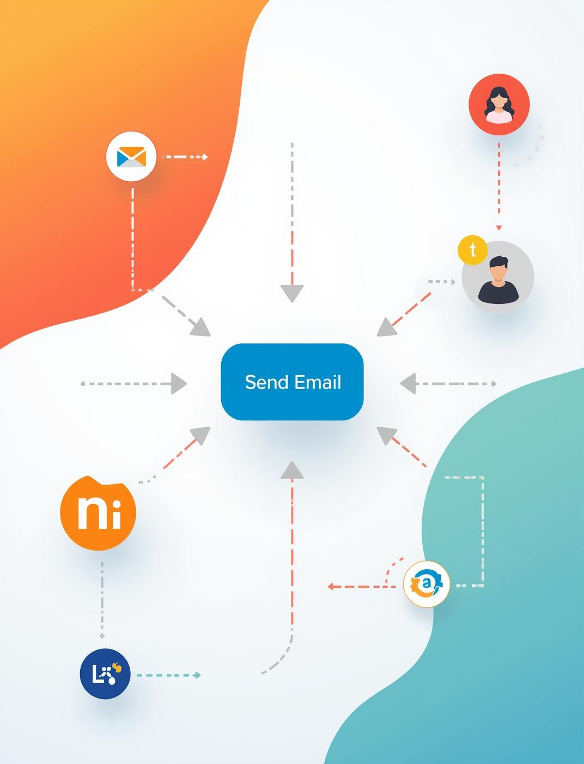
Live Demos
Auto-Reply Workflow
This section showcases how to create, run, and customize your automation by adding nodes, defining rules, and ensuring transparent control over your responses.
Notes:
Dana: “Let’s take a quick suggestion — what else should this agent do?” (Audience: “Auto-reply to urgent messages!”) Josh: “Perfect. Adding a Send Email node with a simple message: ‘Got it — the team’s on it.’ Because it’s open, you can define every rule — nothing hidden.” (Runs workflow; audience sees it reply live.)
Dana: “And that’s an open agent — visible logic, shared

Slide 12
Open-source Empowerment
01
02
03
04
05
Open-source tools are debuggable, allowing users to enhance functionality.
Community-driven projects enable shareable workflows that promote collaboration.
Self-hostable solutions provide users with full control over their setups.
Community nodes foster a culture of forking and remixing code for innovation.
Continuous improvement leads to better agent development through community contributions.
Notes:
Dana: “Let’s talk about why Open-source matters here.” Josh: “With open workflows, you can: 1️⃣ Debug or audit every node 2️⃣ Share and remix ideas across the community 3️⃣ Run locally or on your own infrastructure — full ownership.” Dana: “And that’s the difference — closed agents are opaque. Open agents are teachable, improvable, and transparent

Slide 13
Key Takeaways
01
02
03
04
05
You can do this! These are free tools, and our AI friends are there to help you.
Open tools empower builders to innovate and create solutions collaboratively.
Embracing open-source solutions encourages creativity and ownership in automation projects.
Community-driven contributions enable shared knowledge and continuous improvement of tools.
Most everything is possible through motivation and time.
Notes:
Dana:
“So, we started with inbox chaos and ended with an open agent that reads, decides, and acts.”
Josh:
“In three nodes, we built a workflow that you can fork, modify, and share with anyone.”
Dana:
“Our challenge today:
Fork this agent.
Make it better.
Share it with your team or the n8n community.”
Josh:
“That’s how open-source AI evolves — one small, transparent build at a time.”
Dana:
“Thanks for being part of this — now go build your own agent!”

Slide 14
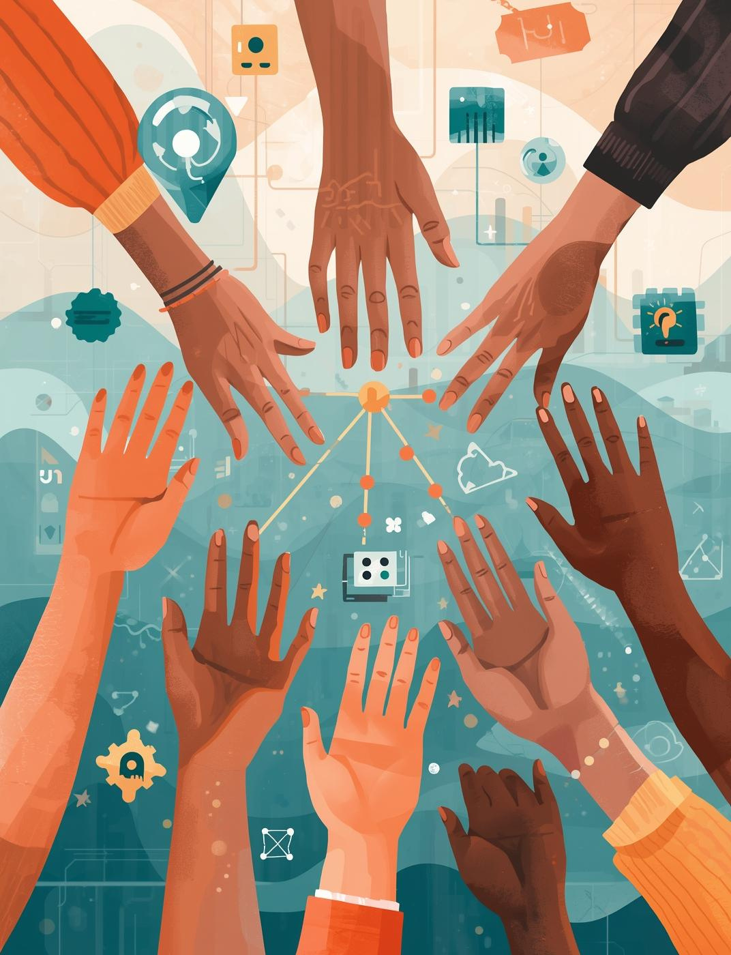
Open Tools, Open Minds
Community Building
By using and contributing your own versions of any tool, you contribute to a vibrant ecosystem, encouraging collaboration and innovation among like-minded builders.

Slide 15

Thank You!
Questions?

